Slide 1
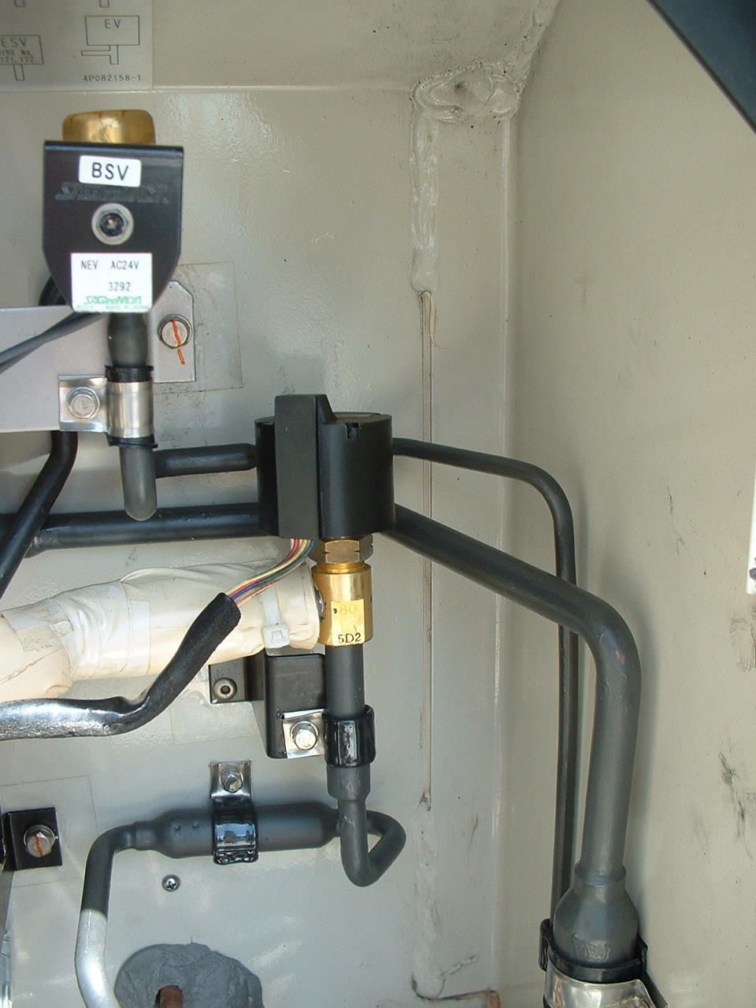
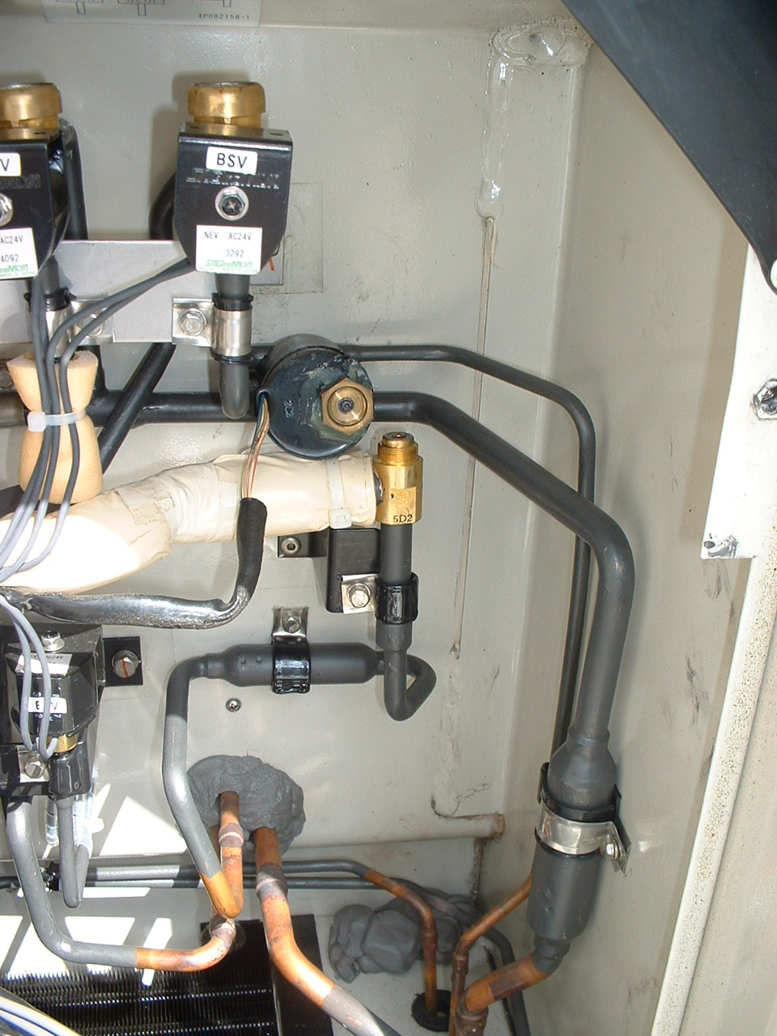
Step 2 : Setting of Electronic expansion valve
Ｓｔｅｐ 2-1 Remove silicone seal
Ｓｔｅｐ 2-1 Remove coil for expansion valve
Silicone seal

Slide 2
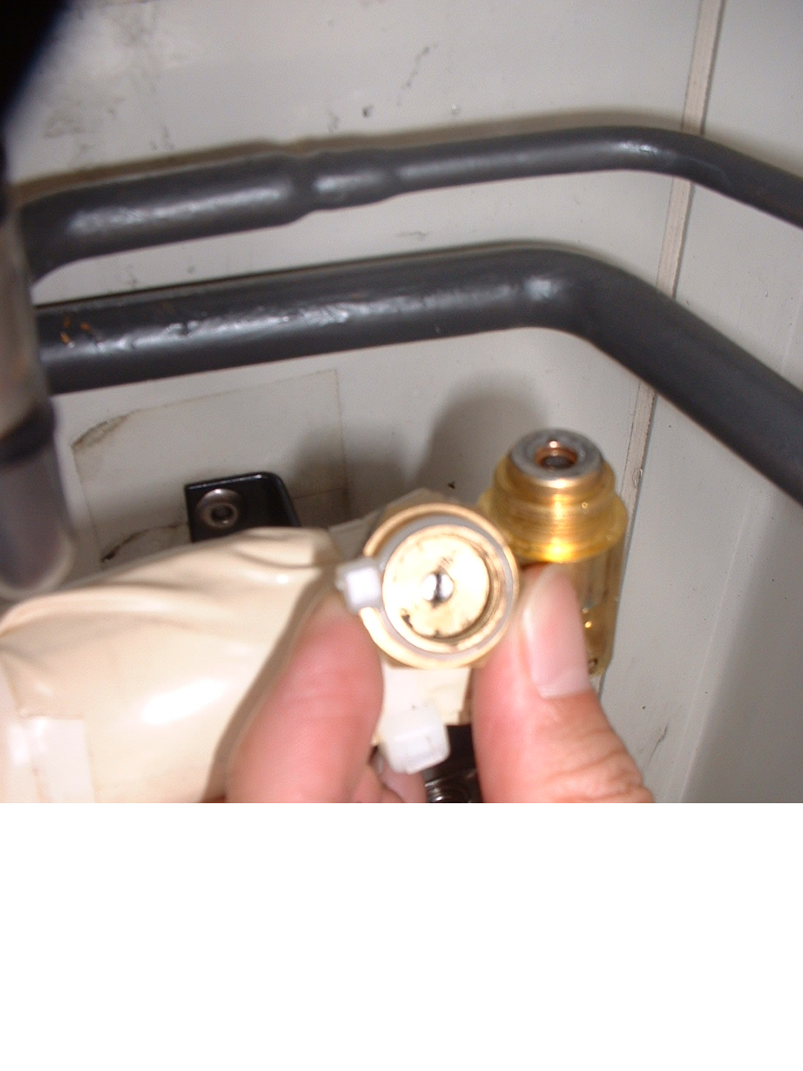
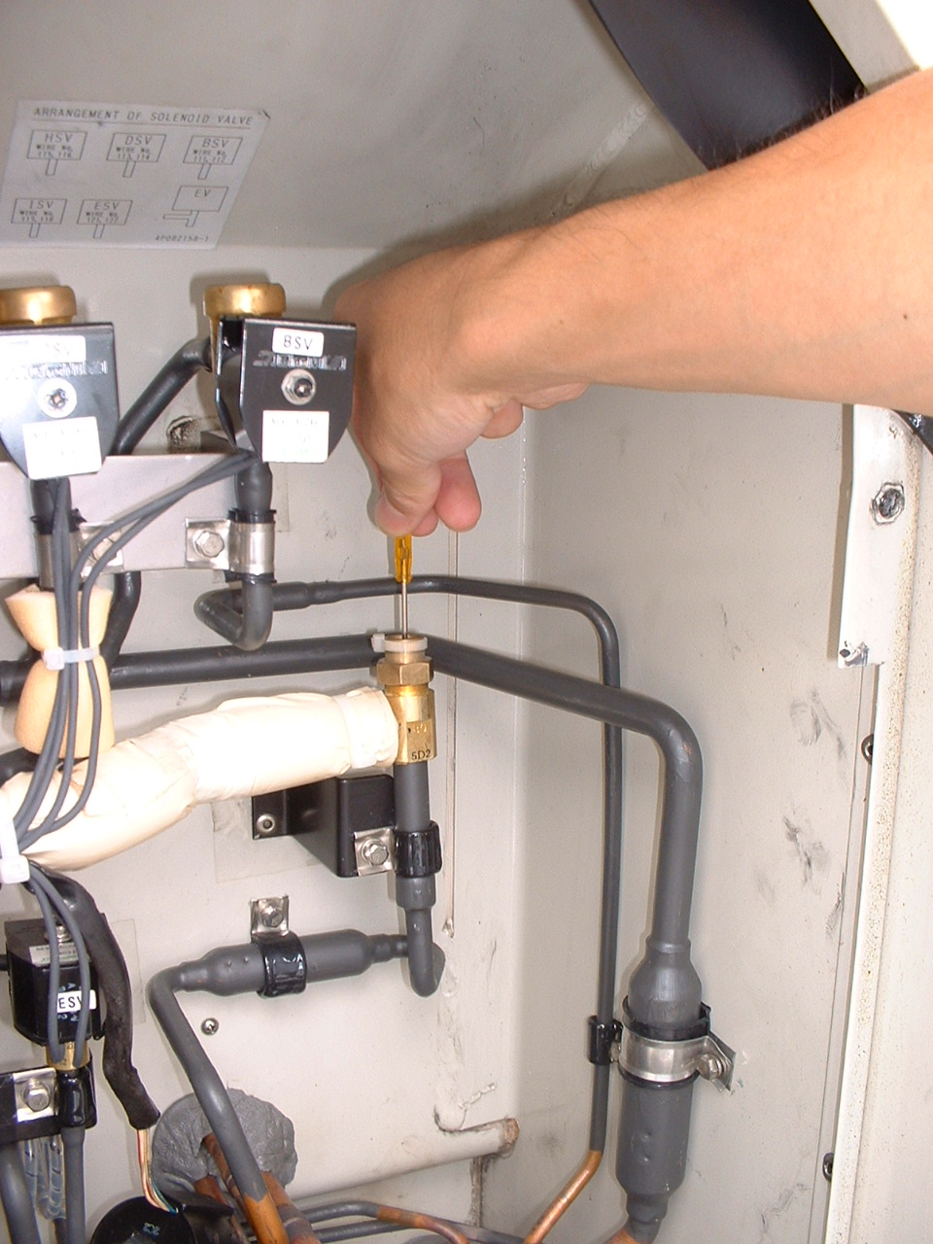
Ｓｔｅｐ 2-3
Put emergency coil cap on valve body
Ｓｔｅｐ 2-4
Close the valve with the Minus screw driver
(Clockwise direction) softly until the driver stop
*Emergency coil cap is in the onboard
spare parts kit

Slide 3
Ｓｔｅｐ 2-5
Slightly open ( 60°）with counterclockwise direction
60°

